Slide 1


Data Science Orientation
Dr. Abolfazl Saghafi
Assistant Professor of Statistics
Data Science Program Director

Slide 2
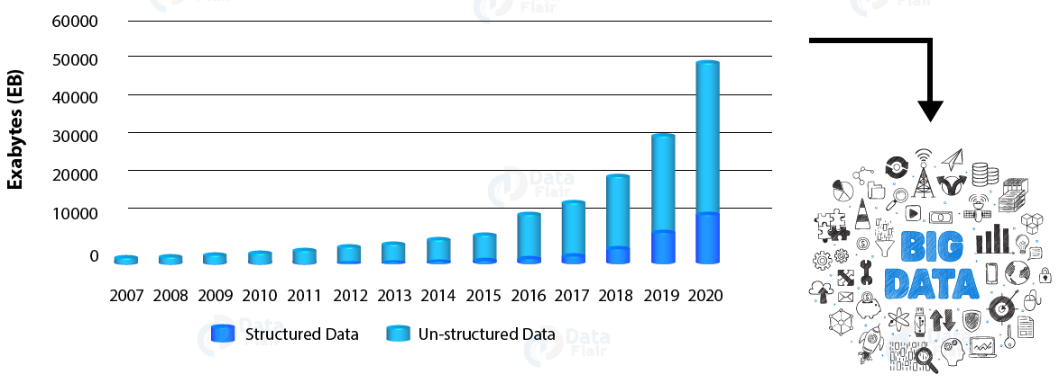
Generated Data
https://data-flair.training
Notes:
1 exabyte (EB) = 10¹⁸ bytes = 1,000⁶ bytes = 1000000000000000000 bytes = 1,000 petabytes = 1 million terabytes = 1 billion gigabytes.

Slide 3
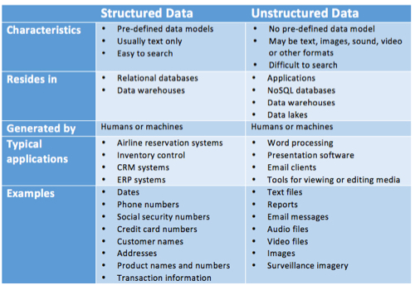
Structured vs. Unstructured Data
https://www.datamation.com/big-data/structured-vs-unstructured-data.html
Notes:
Structured data is comprised of clearly defined data types whose pattern makes them easily searchable; while unstructured data – “everything else” – is comprised of data that is usually not as easily searchable, including formats like audio, video, and social media postings.
Structured data usually resides in relational databases (RDBMS). Structured Query Language (SQL) enables queries on this type of structured data within relational databases.
Typical human-generated unstructured data includes:
Text files: Word processing, spreadsheets, presentations, email, logs.
Email: Email has some internal structure thanks to its metadata, and we sometimes refer to it as semi-structured. However, its message field is unstructured and traditional analytics tools cannot parse it.
Social Media: Data from Facebook, Twitter, LinkedIn.
Website: YouTube, Instagram, photo sharing sites.
Mobile data: Text messages, locations.
Communications: Chat, IM, phone recordings, collaboration software.
Media: MP3, digital photos, audio and video files.
Business applications: MS Office documents, productivity applications.
Typical machine-generated unstructured data includes:
Satellite imagery: Weather data, land forms, military movements.
Scientific data: Oil and gas exploration, space exploration, seismic imagery, atmospheric data.
Digital surveillance: Surveillance photos and video.
Sensor data: Traffic, weather, oceanographic sensors.

Slide 4
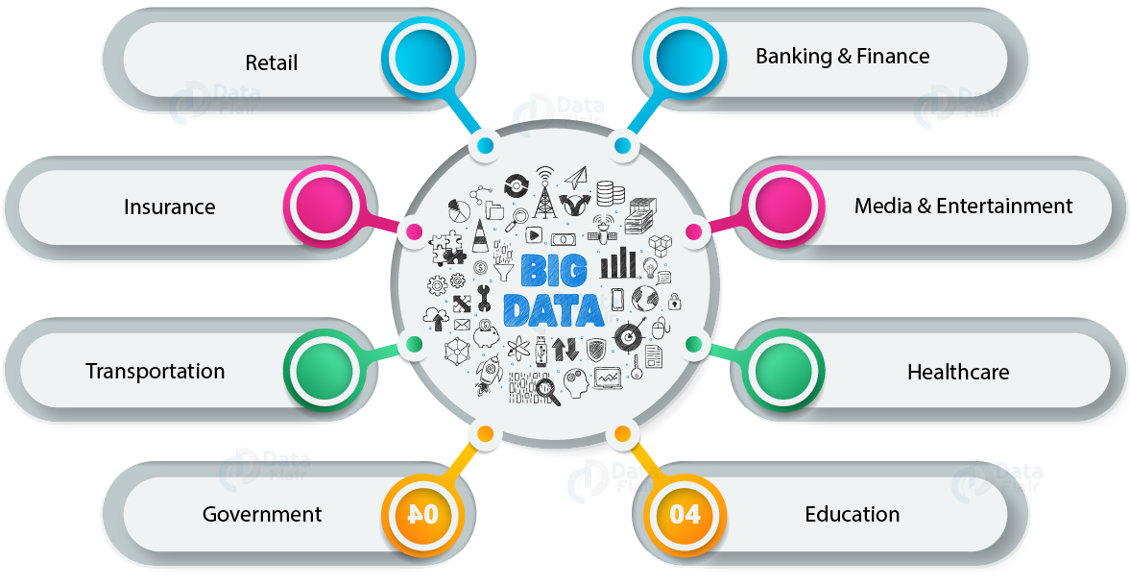
BIG Data Everywhere
https://data-flair.training
Notes:
These type of data can be find everywhere

Slide 5
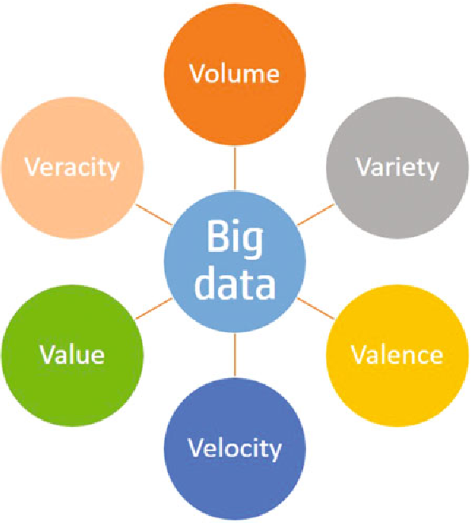
BIG Data
Volume, referring to vast amounts of data that is generated every second.
Velocity, referring to the speed that is data is generated.
Variety which is increasing different forms that data is generated.
Valence is the connectedness of the data.
Veracity refers to the biases, noise, and abnormality in data.
Nitin Upadhyay, CABology: Value of Cloud, Analytics and Big Data Trio Wave, Springer, 2018.
At the heart of the big data challenge is turning all of the other dimensions into truly useful business Value.
Notes:
Today, we are facing a BIG data problem and a shortage of people who can efficiently handle such data. BIG data is often characterized by five Vs.

Slide 6
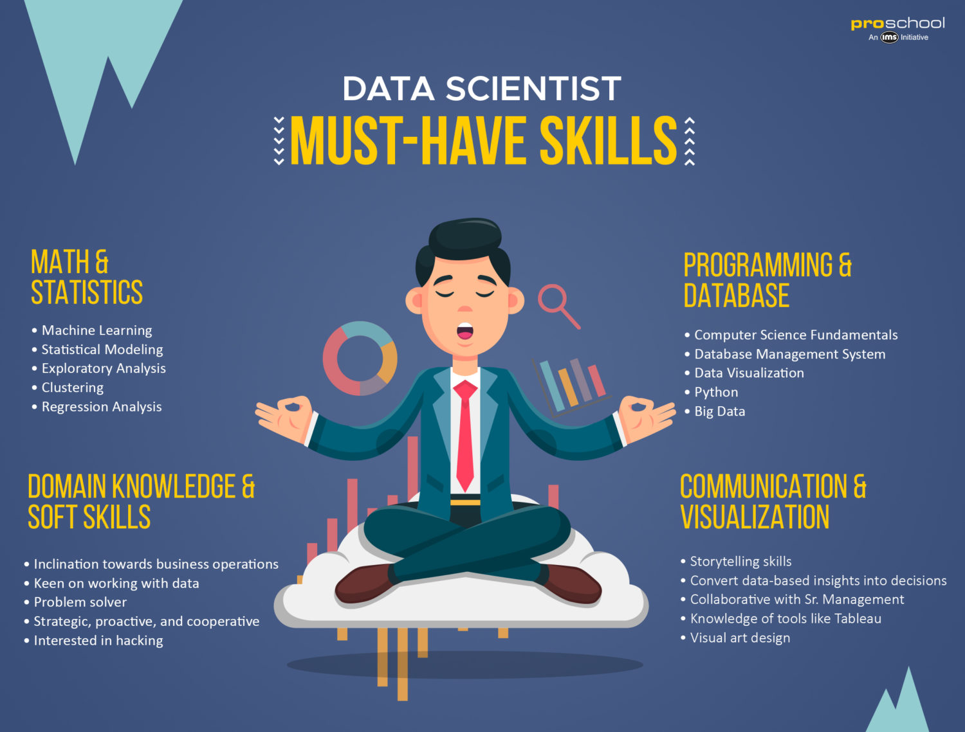


Data Scientist
https://www.proschoolonline.com/blog/data-science-skills
https://visual.ly
Notes:
Data scientists are superheroes, saving the day! They have a well-equipped set of skills. All of you already have these skills to some degree, what you need is to nurture them, you need a Yoda!
(1) Math & Statistics:
Data Science skills is all about deciphering the underlying insights from the data sets, which involves a strong command over statistics. As a budding Data Scientist, you should be well-versed with concepts like testing hypotheses, distributions, Bayesian Analysis, Identifying the best estimator, Parameter estimation etc.
A mastery over core statistical concepts like Linear Regression, Time-series Analysis and non-straight regression are also quintessential attributes of a Data Science.
(2) Mathematical skills:
Certain mathematical concepts like Multivariate Calculus, Liner Algebra, and Probability theory form the basis for Data Science. Most of the Data Scientists have a strong knowledge about Applied Mathematics which helps them to sail through their role with ease.
Even those who do not have a background in mathematics need to gain a strong foothold in these concepts. We have observed that the companies usually prefer candidates who have an academic qualification in Maths and Stats such as Ph.D, Masters in Applied Mathematics, Masters in Statistics, etc.
(3) Programming skills:
It goes without saying that for a rewarding career in Data Science, you must have a strong computing mind set and the ability to understand codes. An expert level knowledge of programming languages play a big role in determining your success in your career as a Data Scientist. To begin with, the knowledge of R is a must-have in the kitty.
R is a programming language that is used in most of the statistical problem-solving in Data Science and is specially designed for the scientists. Python is also a widely-used language in Data Science and is relatively simpler to grasp and use.
Python can also be used across large data-sets and also in creating data sets. More than half of the world’s Data Scientists vouch for Python as the foundation for executing data analysis projects.
(4) Participation in real-world events:
Today there are a lot of hackathons, events, coding seminars and Data science meets organised by leading companies to groom young talent and also scout for the best. Participation in these events not only helps you to network easily but also broaden your knowledge horizon to face real-world challenges.
Bootcamps, Workshops on AI and Machine Learning help you in taking your skills to a whole new level and also gives you an edge over other candidates who are more focussed on theoretical concepts. Some of the well-known events for Data Science are Data Science Congress, Practicla Machine Learning & Data Science Workshop, DataHack Summit etc.
(5) Comfort with unstructured data:
Data Scientists have to work with vast amounts of data most of which is also unstructured. This data is taken from obscure places, social media, videos, blogs, audios, web sites, and other open data sources.
Sanitizing such data sets and structuring them into an organised pattern requires an eye for detail and a sorted thought process. There are many software and tools such as Hadoop, Apache, NoSQL, Polybase to handle unstructured data and a data scientist should be able to handle them very well.
(6) Data Storytelling:
Knowing how to present your insights is as important as being able to handle to derive these insights. The insights have to be presented in a form that is relatable to the various stakeholders. Data Scientists who are adept at this present their findings through Data Visualisation techniques and weave the insights into a story that is crisp, engaging and relatable to everyone involved in the decision making process.
The various tools that aid the Data Scientists in visualisation and storytelling is Tableau, Plotly, Chart.js, DataHero etc. Presenting the data in an easily comprehensible manner helps the decision makers to understand complex insights better, thus aiding faster decision-making.

Slide 7






The Data Science Team
Abolfazl Saghafi, PhD²
Director, Data Science
Assistant Professor of Statistics, Data Scientist
Randy Zauhar, PhD
Professor of Chemistry & Biochemistry
Computer-aided Drug design
Carl Walasek, MSc
Instructor of Statistics
Director, Biostatistical Methods with SAS Cert.
Thierry Petit, PhD
Assistant Professor of Data Science
Online Program Specialist
Zhijun Li, PhD
Professor of Bioinformatics
Director, MS Bioinformatics
Notes:
Here are the Yodas to help you hone your skills so you can use your powers on command!
ABO – PhD in Statistics from University of South Florida and PhD in Applied Mathematics from Iran University of Science & Technology; interests: Machine Learning, Deep Learning, BIG Data, Time Series Data
CARL – MSc in Statistics from DePaul University; Interests: Bayesian Statistics and Statistical Computing
RANDY - PhD in Molecular and Cell Biology from Penn State University; interests: computational chemistry, bioinformatics, computer-aided drug design; designing drug molecules (inhibitors) against highly mutable targets such as HIV protease
THIERRY - Ph.D. in Computer Science in 2002 from the University of Montpellier (France) and his French “Habilitation” (HDR) in 2014 at the “Institute Mines-Telecom” in Nantes (France). He is an expert in algorithmic approaches for solving discrete optimization problems. His primary research area is Constraint Programming, at the frontier of Artiﬁcial Intelligence and Operations Research
ZHIJUN – PhD from Vanderbilt University; interests: Using computational and bioinformatic methods to generate and analyze three-dimensional structures of protein molecules, and to gain insight into protein sequence, structure, and function relationships.

Slide 8
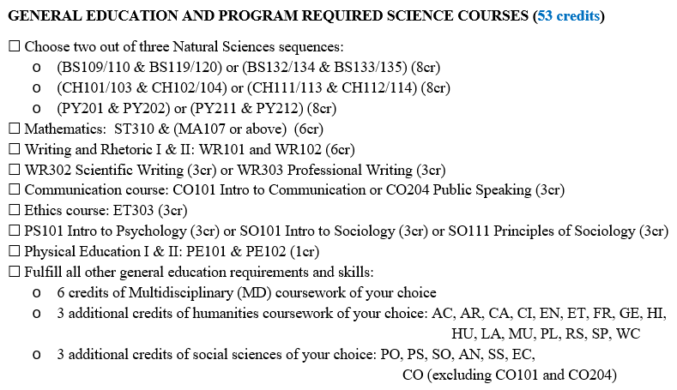

Bench/Lab Science
Communication

Slide 9

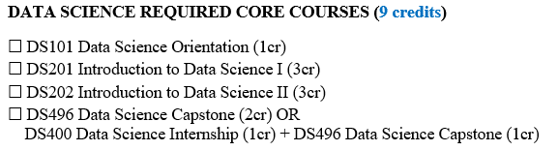

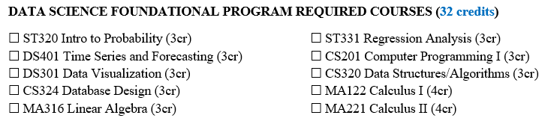


Slide 10
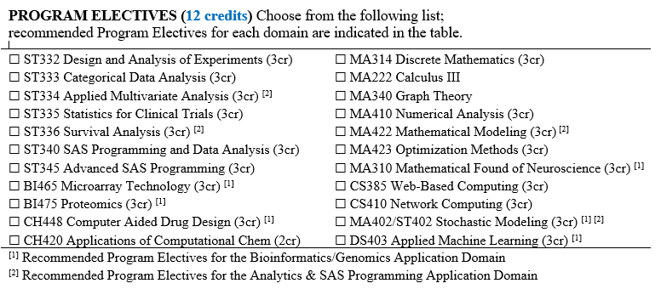



Slide 11
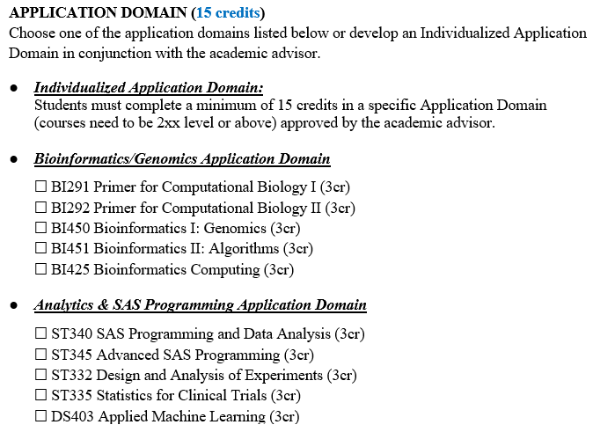

Notes:
124 credits in total

Slide 12
Data Science Orientation
Week 1. Welcome! Introduction to Course and Program Review
Week 2. What is Data Science? Contemporary Areas of Research.
Week 3. DS Faculty. Key faculty in the DS program and their research area.
Week 4. Project in Data Science and looking for data.
Week 5. Intro. Data Science Process.
Week 6. Introduction to Course and Program Review
Week 7. Introduction to Course and Program Review
Week 8. Introduction to Course and Program Review
Week 9. Introduction to Course and Program Review
Week 10. Introduction to Course and Program Review
Week 11. Introduction to Course and Program Review
Week 12. Introduction to Course and Program Review
Week 13. Introduction to Course and Program Review
Week 14. Introduction to Course and Program Review

Slide 13
Grading Rubric
100%
20% - A
40% - Q
30% - P
10% - C
Attendance (A): Students are required to attend all meetings unless they are legitimately excused by the instructor.
Weekly Quizzes (Q):
With three attempts, weekly quizzes cover material of each week and should be completed within 10 days once they are available to score their credit.
Project (P):
The subjects and descriptions will be released once you score at least 40% on week 9 quiz.
Participation (C): Students are encouraged to ask questions during class and actively participate in all activities and not to play with their phones.
Notes:
Check out course syllabus for a tentative list of subjects discussed in each class

Slide 14


Answer the following questions. Write down your answers, you will be asked to talk about them in class, you will need to enter your answers on D2L on Week 2 Quiz.
Q1. What do you think Data Science is? Think about.
Q2. What areas and applications of data science are you currently interested in investigating? Rank 3 and explain each. Is there a reason for your selection and ranking?

